Slide 1
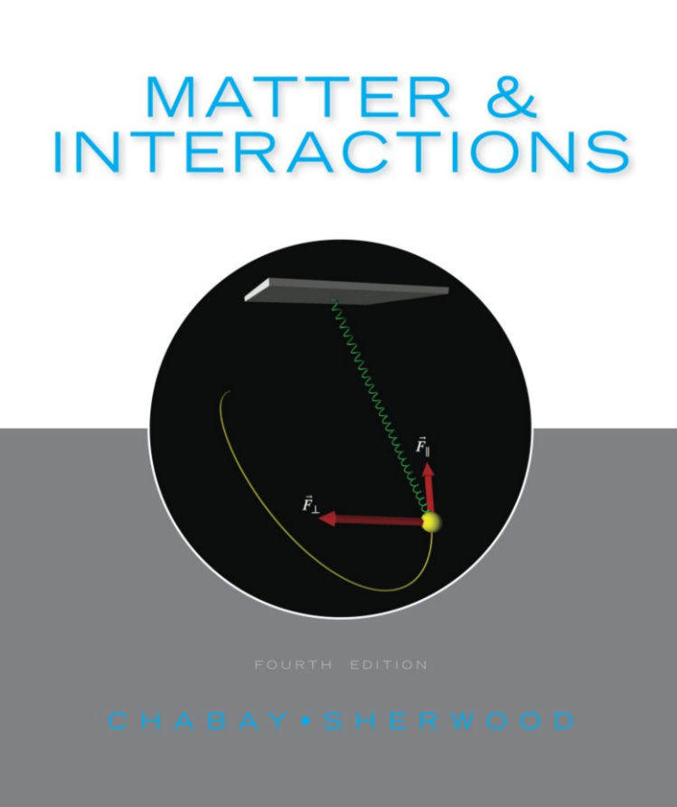


Background Information
General Physics II: Calculus-Based
PHYS 2331
Dr. Amy Roberts
Vectors
SI Units
Velocity and Acceleration

Slide 2
Background Information
Content
Vectors
Click through the slides to review information pertinent to Physics II.
OR
Click a topic on the right to jump to a
particular slide.
SI Units
Velocity and Acceleration

Slide 3

Background Information
Vectors

Slide 4
Background Information
SI Units

Slide 5
Background Information
Velocity and Acceleration

